Slide 1
Capstone Project
Bigdata – Bootcamp by Analytixlabs

Slide 2
Business Objective
We are required to find the employee retention rate / reasons for employee leaving the org, given the data for time period of 1980 to 1995 ,
We do a basic EDA on the given data set,
Do wrangling to clean the data .
Do feature engineering to make variables that are relevant to analyisis

Slide 3
Why we use big data engineering ?
We will be importing the data from mysql to HDFS using Sqoop , creating our own schema , the data model we design should be able to hold all the data. We perform the analysis using Hive then spark and then Spark ML for prediction, and then we create a pipeline for the same.

Slide 4
Data Given
The data given is in .csv format of employee details, titles, department, department managers, department employees and Salaries.
These data is stored in My Sql based on the schema in the next slide

Slide 5
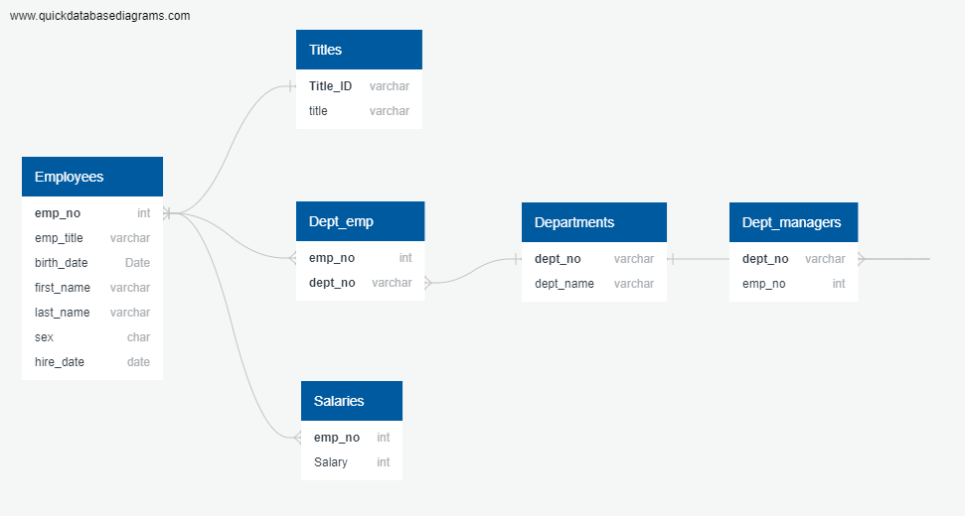

Slide 6
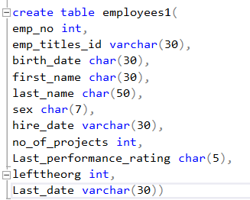
Technology Stack used
Sample table
Data is stored in MySQL
It is then moved to hdfs using Sqoop in avro format
It is then loaded into hive using hdfs
Analysis is done using HDFS
The data is then moved to Pyspark
Analysis is done using spark.sql and spark.mlib

Slide 7
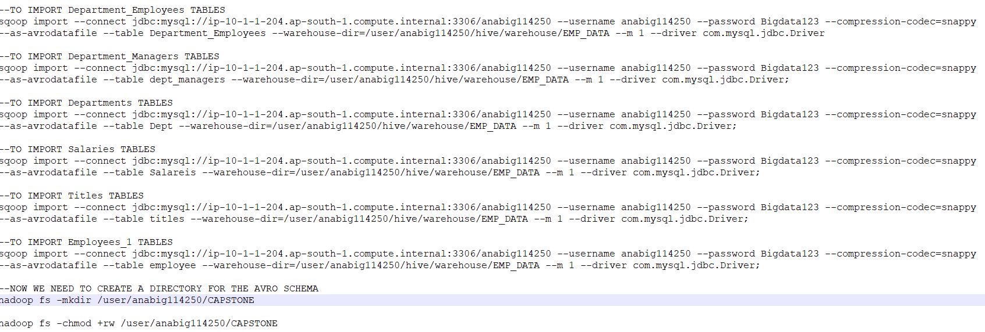
Data ingestion using Sqoop
Snippet of sqoop
Complete code is submitted

Slide 8
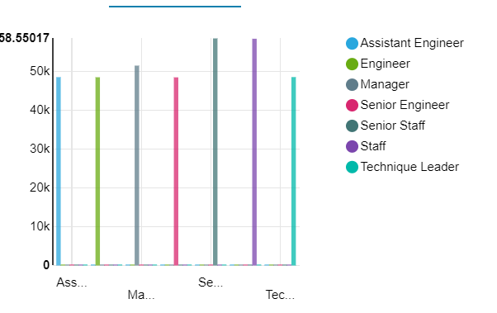
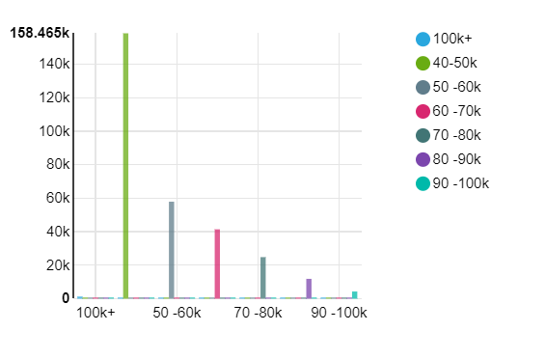
Analysis using Hive
Avg salary by dept
Salary bracket

Slide 9
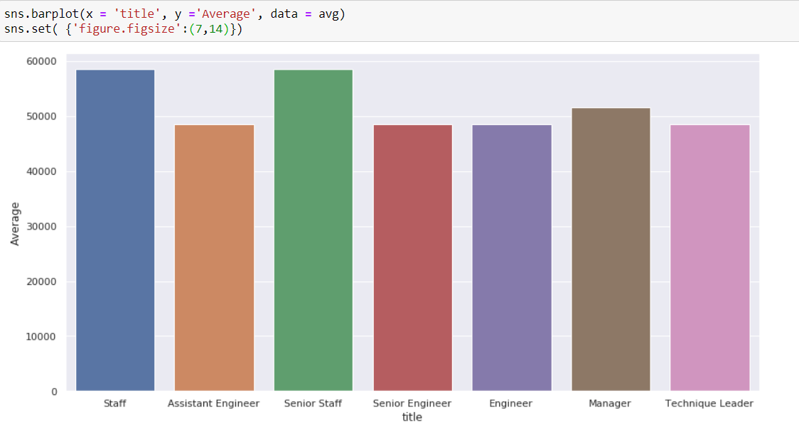
Analysis using pySpark

Slide 10
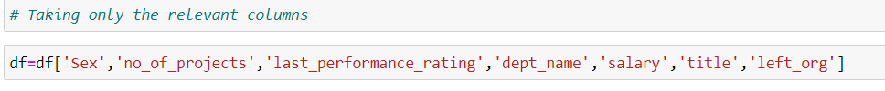
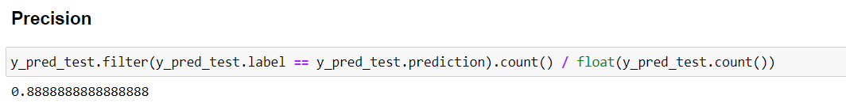
Prediction using Mlib
Using logistic regression and using the following columns
We get a Precison of around 88%

Slide 11
Challenges Faced
While creating schema, it is important to keep data uniformity so that connection with other tables can be made easily
HDFS cluster had maintenance going on this impacted the project, because some part of the project was not saved and had to re work on everything

